Slide 1


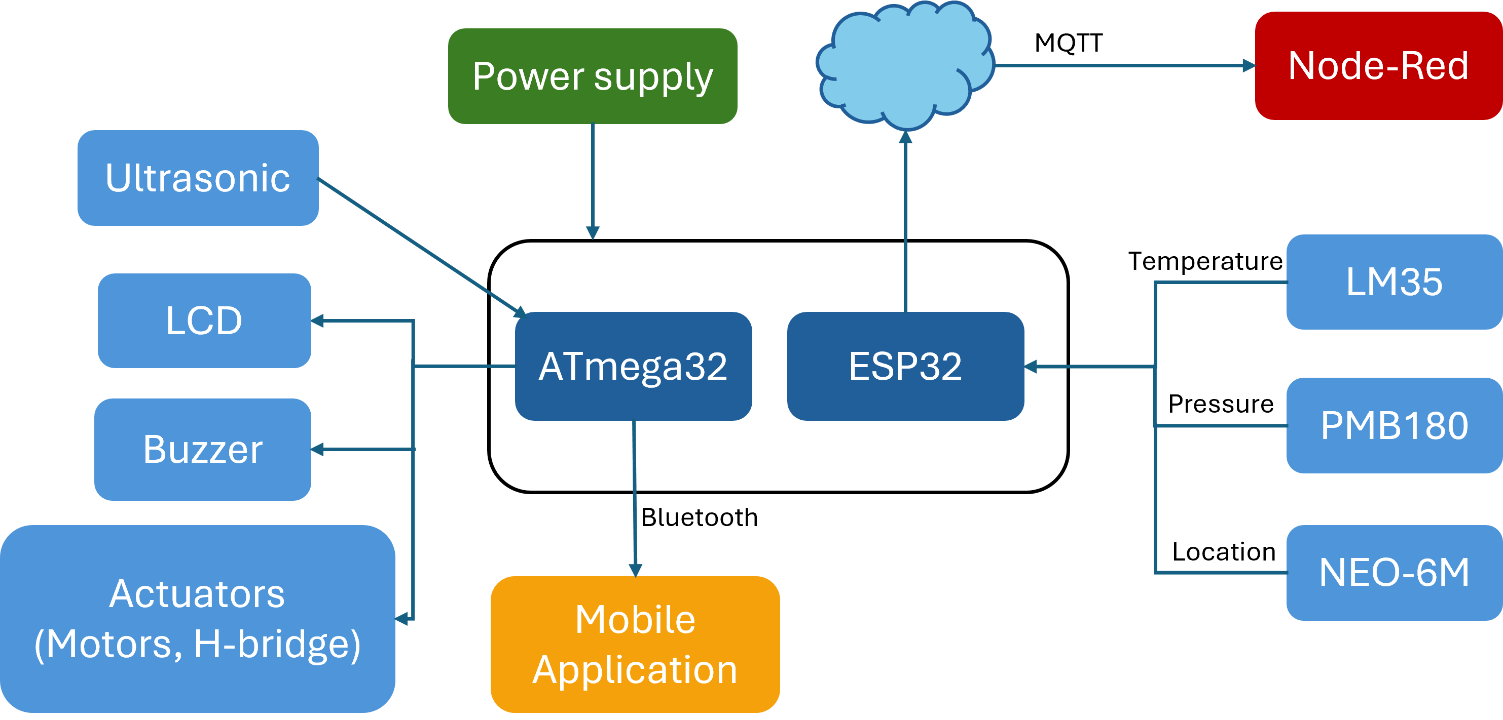
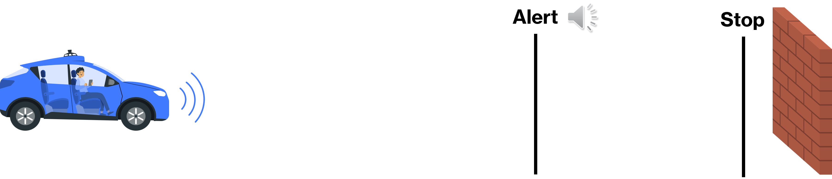
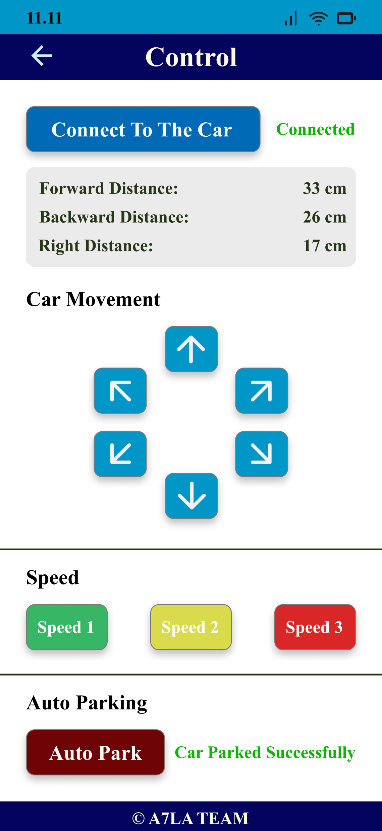
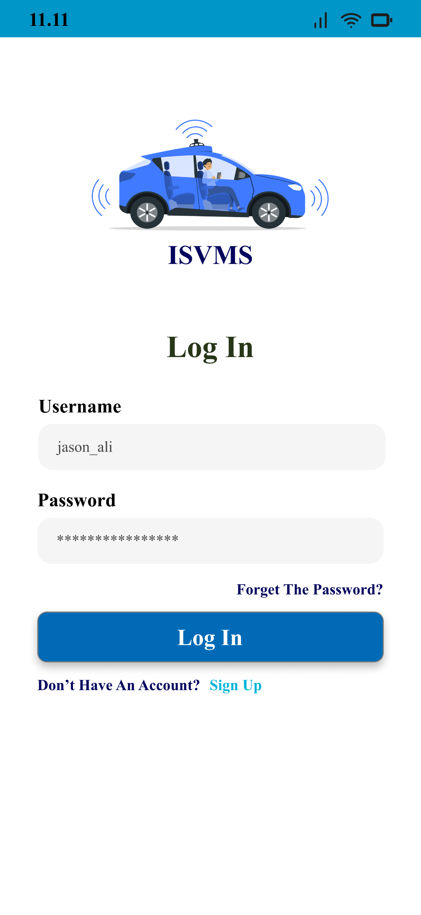
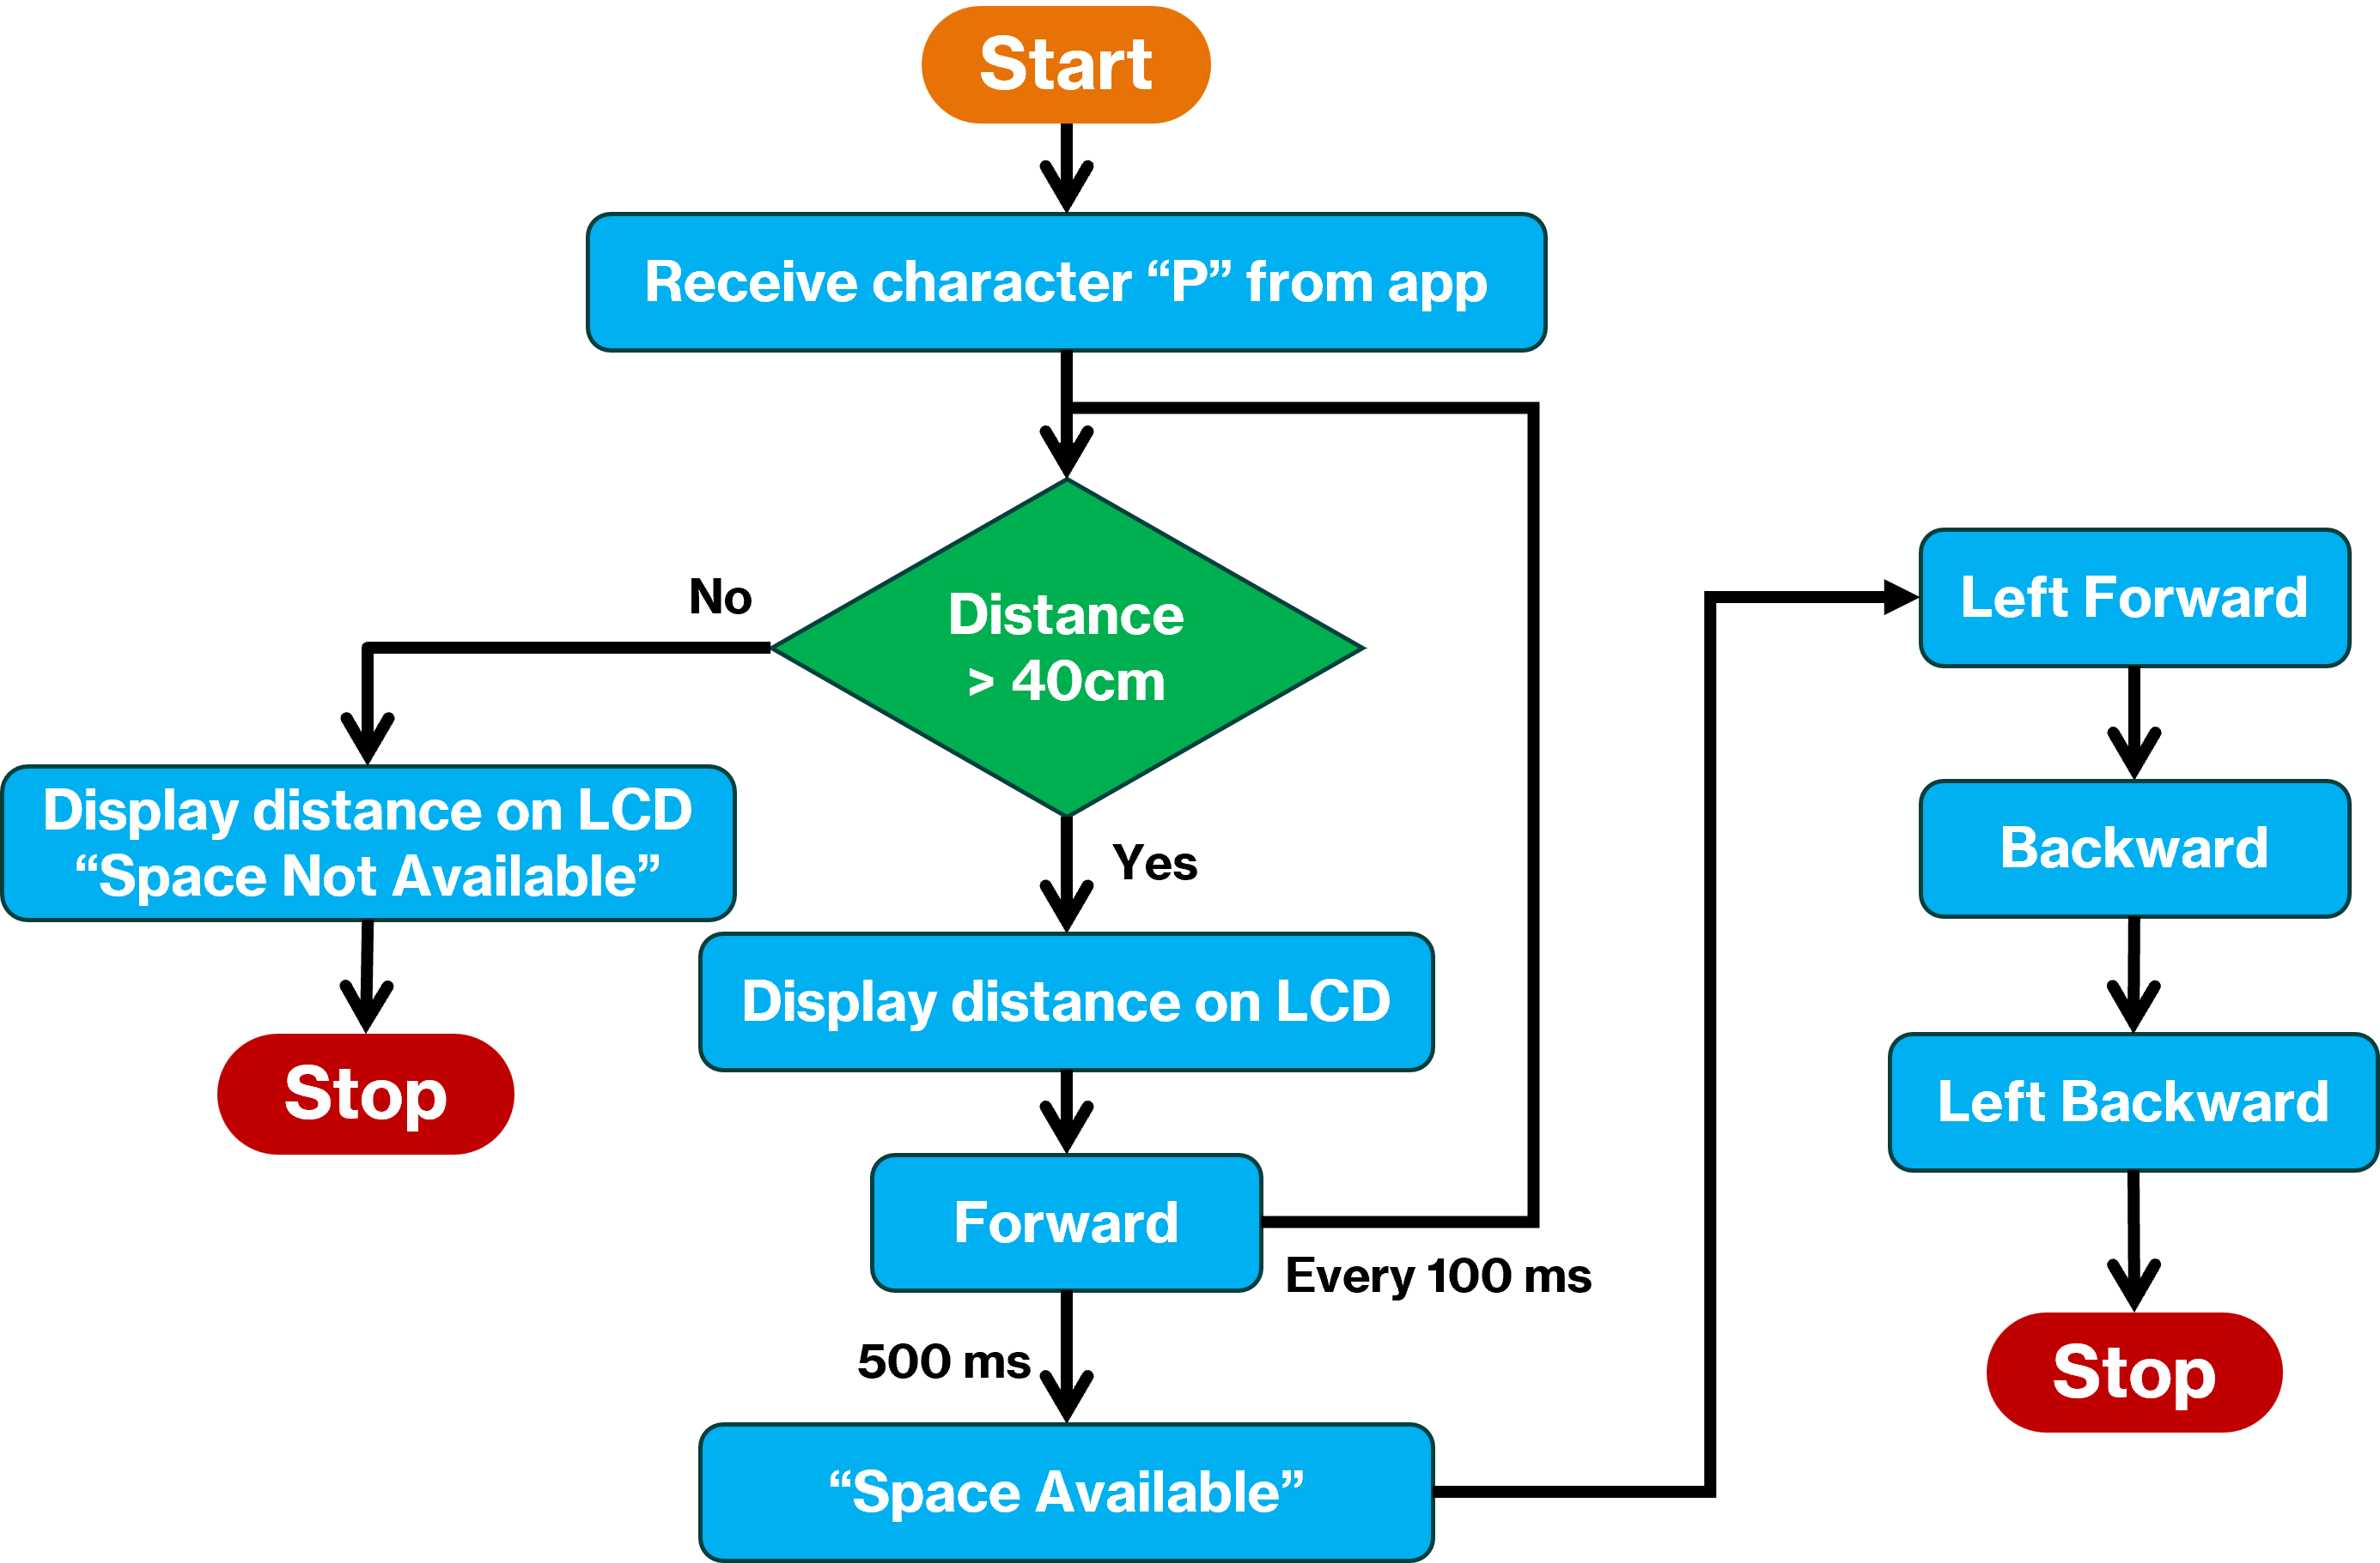
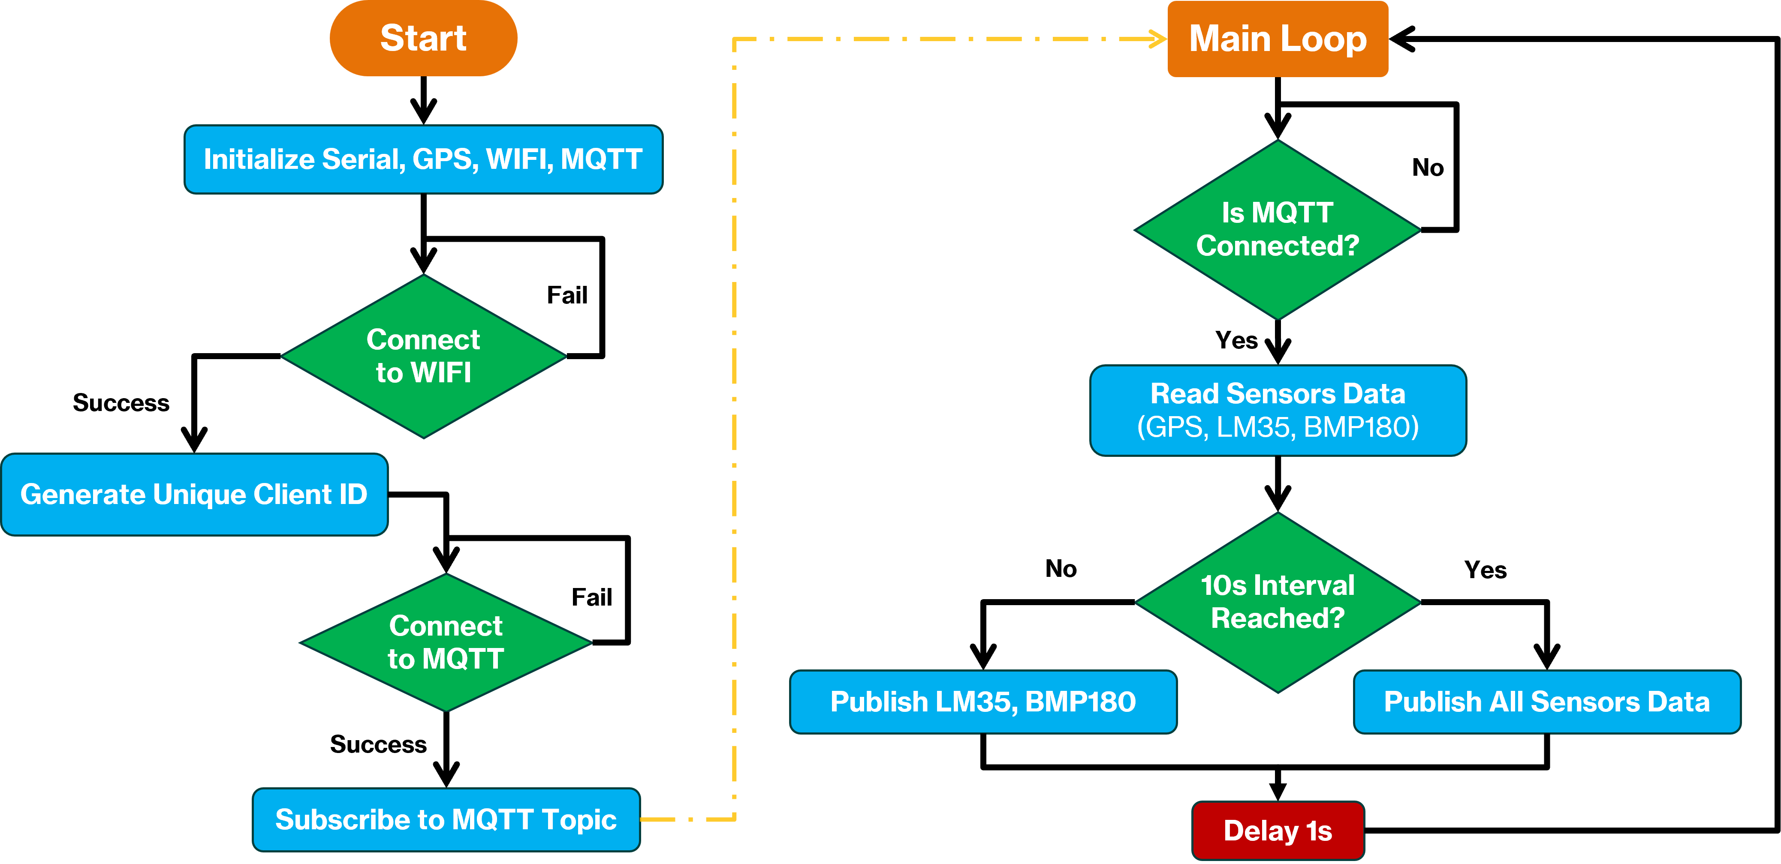
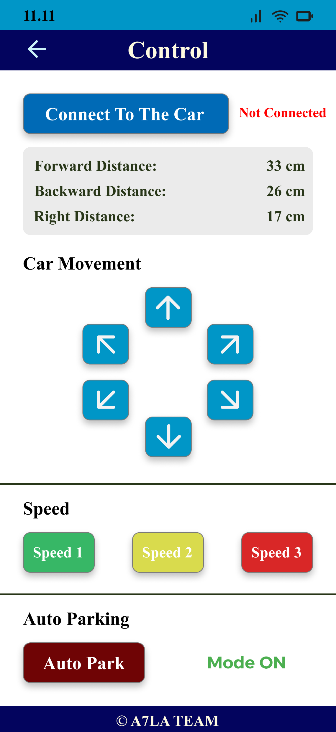
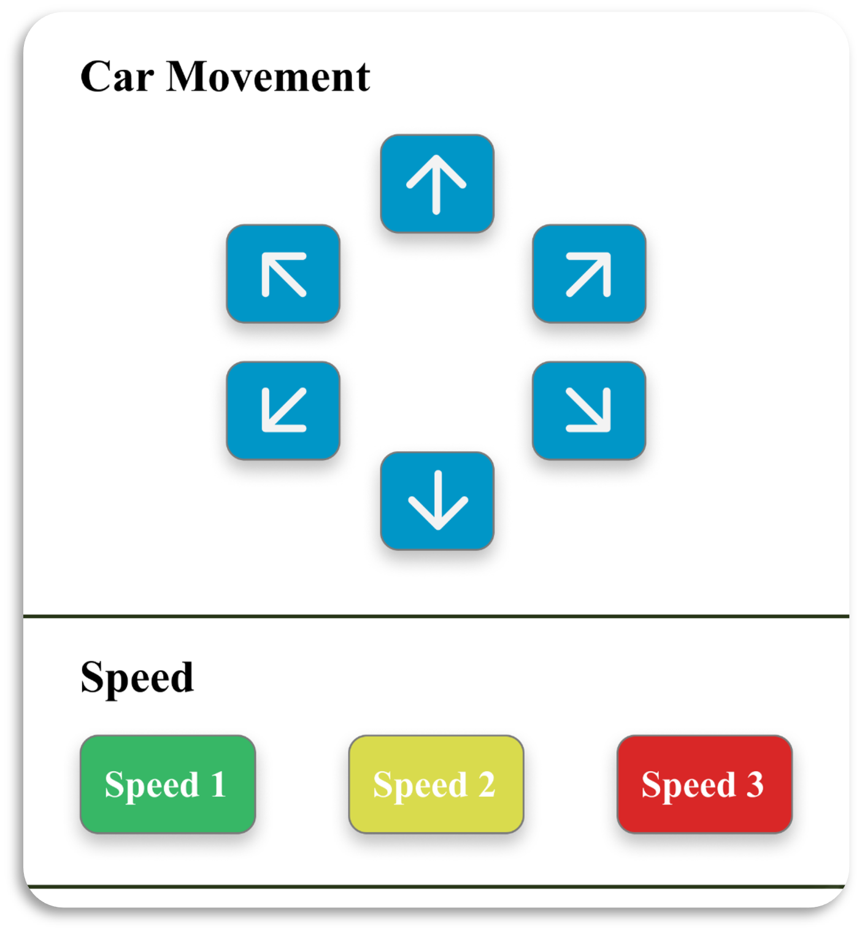
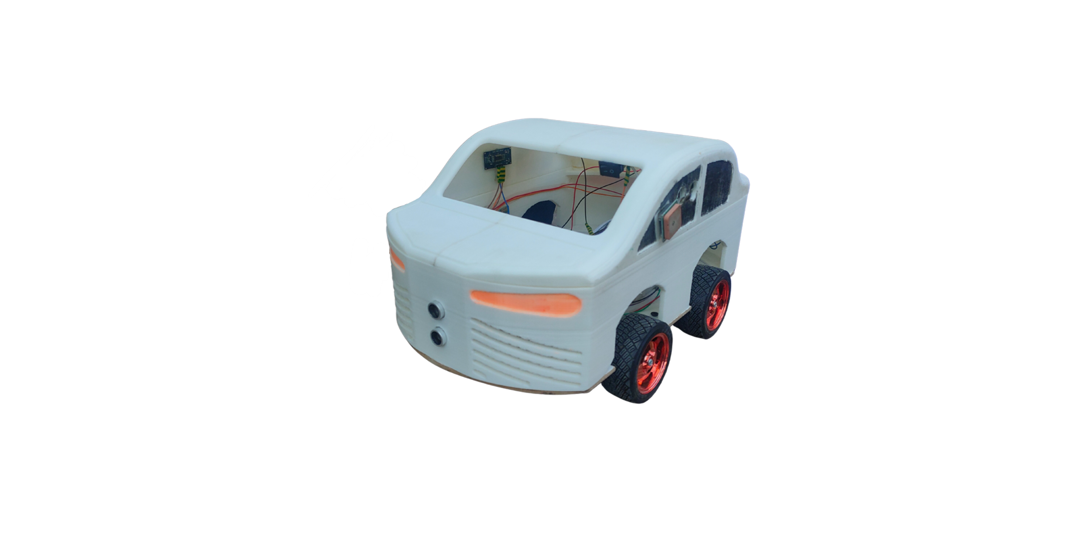
Integrated Smart Vehicle Management System (ISVMS)
13 july, 2025 Zagazig university, Faculty of Engineering, Department of Electronic and Communication Engineering
Project Overview
Develop an advanced vehicle management system to enhance driving safety, automation, and real-time monitoring using IoT and embedded systems which reduces human error in driving.
System Architecture
Collision Avoidance
The two ultrasonics checks the distance in front and behind the robot. If an object is too close (≤20 cm) while moving, it either activates a buzzer (warning) or stops the robot and turns off the buzzer if the object is very close (≤10 cm).
These distance readings are also sent to the mobile application for display.
IoT & Maintenance
The ESP32 connects to WiFi and publishes GPS, temperature (LM35 & BMP085), and pressure data to an MQTT broker. It sends GPS updates every 10 seconds and continuously monitors sensor values on node-red dashboard.
App Authentication
Auto Parking
The car automatically parked by checking the right-side
distance using an ultrasonic sensor. If a free space
(≥30 cm wide) is detected consistently, it confirms
availability, displays “SPACE Available” on the
LCD, and executes a predefined parking maneuver
using a sequence of directional movements. If no
space is found, it displays “NO SPACE”.
Vehicle Control
The microcontroller received
command to control the car
movement and motor speed.
It executes actions like moving,
turning, stopping, or changing
speed based on the received
command.
Our Car
Team: Mahmoud Esmat, Muhammed Ayman, Mahmoud Ashraf, Salma Osama, Omnia Wael, Hadeer Ehab, Hagar Saad, Rehab Nasser, Sara Reda
Supervised by: Dr. Rania Ahmed, Dr. Azhar Ahmed

